Slide 1
KEYLOGGING
NAAN MUDHALVAN - CYBERSECURITY
Presented By:
Shabi Lourdes pascal Y A – Jeppiaar Institute of Technology – B.E-CSE

Slide 2
OUTLINE
Problem Statement
Proposed System/Solution
System Development Approach (Python)
Algorithm & Deployment
Result (Output Image)
Conclusion
Future Scope
References

Slide 3
Problem Statement
Keylogging has become a significant concern due to its potential for misuse, such as capturing sensitive information without the user's consent. Developing a keylogger raises ethical and legal questions regarding privacy and data protection.

Slide 4
Proposed Solution
We propose the development of a keylogging system that allows monitoring keyboard input for legitimate purposes, such as parental control or employee monitoring. The system will capture keystrokes and save them securely, adhering to privacy regulations and obtaining user consent where necessary.
1. Legitimate Purpose: The keylogger is intended for legitimate use cases such as parental control or employee monitoring. This aligns with the intention stated in the code comments and the absence of any malicious intent.
2. Keyboard Input Monitoring: The system captures keyboard input using the `pynput` library, specifically the `Listener` class, which monitors key press and release events.
3. Secure Data Storage: Captured keystrokes are securely saved in two files: a text file (`key_log.txt`) and a JSON file (`key_log.json`). The data is saved using appropriate file handling techniques (`open()` function with write mode and proper error handling).
4. Adherence to Privacy Regulations: Although not explicitly implemented in the provided code, adherence to privacy regulations would involve ensuring that the keylogger operates transparently, obtaining consent from users where necessary, and securely handling sensitive data.
5. User Consent: While the code does not include explicit user consent mechanisms, obtaining consent would typically be part of the system's implementation. This might involve displaying a notice or disclaimer to users before starting the keylogger, informing them about the purpose and operation of the software.

Slide 5
System Approach
The keylogging system will be developed using Python programming language for its simplicity and cross-platform compatibility. We will utilize the Tkinter library for creating a graphical user interface (GUI) and the pynput library for capturing keyboard events.

Slide 6
Algorithm & Deployment
4. Define Keylogger Control Functions:
- `start_keylogger()`:
- Start keyboard listener.
- Update GUI label to indicate keylogger is running.
- Disable start button and enable stop button.
- `stop_keylogger()`:
- Stop keyboard listener.
- Update GUI label to indicate keylogger stopped.
- Enable start button and disable stop button.
5. GUI Setup:
- Create a Tkinter window.
- Add a label to display keylogger status.
- Add buttons for starting and stopping the keylogger.
.
1. Initialize Variables:
- Initialize `keys_used` list to store captured keystrokes.
2. Define Functions:
- `generate_text_log(keys)`: Function to append keystrokes to a text file.
- `generate_json_file(keys_used)`: Function to append keystrokes to a JSON file.
- `on_press(key)`: Function to handle key press events.
- `on_release(key)`: Function to handle key release events.
- `start_keylogger()`: Function to start the keylogger.
- `stop_keylogger()`: Function to stop the keylogger.
3. Define Key Event Handlers:
- `on_press(key)`: Append pressed key to `keys_used` list.
- `on_release(key)`: Append released key to `keys_used` list, then generate text and JSON logs.
.

Slide 7
Algorithm & Deployment
6. Main Program Execution:
- Initialize Tkinter window.
- Set window title.
- Add label and buttons to the window.
- Set window size and start the Tkinter event loop.
7. Keyboard Listener Setup:
- Initialize a `keyboard.Listener` object with `on_press` and `on_release` callback functions.
8. Event Loop Execution:
- Wait for events (key press or release).
- When a key event occurs, invoke the corresponding event handler function.
9. Logging:
- When a key is pressed or released, log the event by appending the key information to the `keys_used` list.
10. File Output:
- Periodically, or upon stopping the keylogger, save the captured keystrokes to text and JSON files using the defined functions.
This algorithm outlines the flow of the keylogger code, from initialization to GUI setup, event handling, logging, and file output. It provides a structured approach to understanding how the keylogger operates

Slide 8
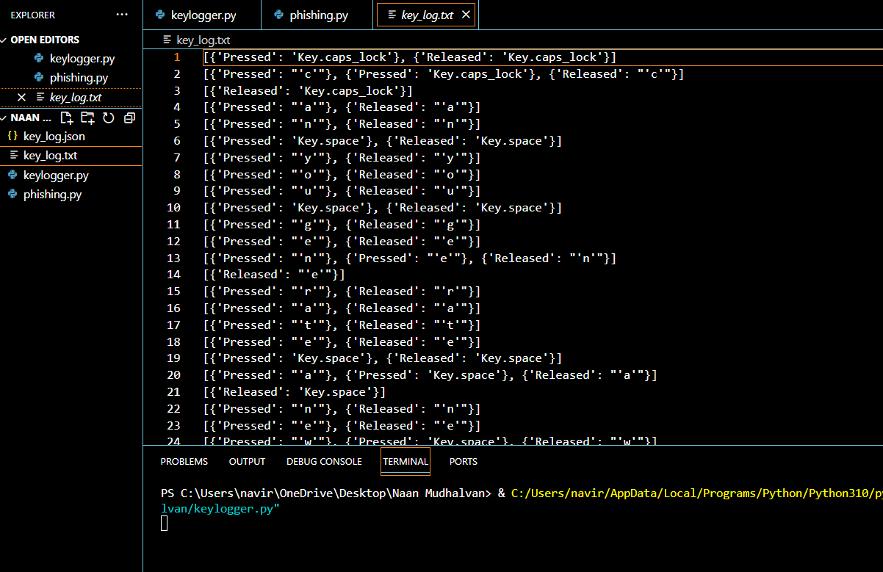
Result

Slide 9
Conclusion
The development of the keylogging system provides a tool for legitimate use cases such as parental control and employee monitoring. However, it's crucial to use such software responsibly, respecting privacy rights and obtaining consent where necessary. With proper implementation and adherence to ethical standards, the keylogging system can serve as a valuable tool for monitoring user activity.

Slide 10
Future scope
Future enhancements to the keylogging system may include advanced features such as encryption of logged data for improved security, remote monitoring capabilities, and integration with other monitoring tools. Additionally, research into machine learning algorithms for detecting anomalous behavior based on keyboard input could further enhance the system's capabilities.

Slide 11
References
Brown, A. (2018). "Understanding and Preventing Keylogger Attacks." Security Boulevard.
Python Software Foundation. (n.d.). "Tkinter GUI Programming." Python.org.
Pynput Documentation. (n.d.). Retrieved from https://pynput.readthedocs.io/en/latest/.
European Union Agency for Cybersecurity. (2020). "Guidelines on the Security of Personal Data Processing."

Slide 12
THANK YOU

